Slide 1
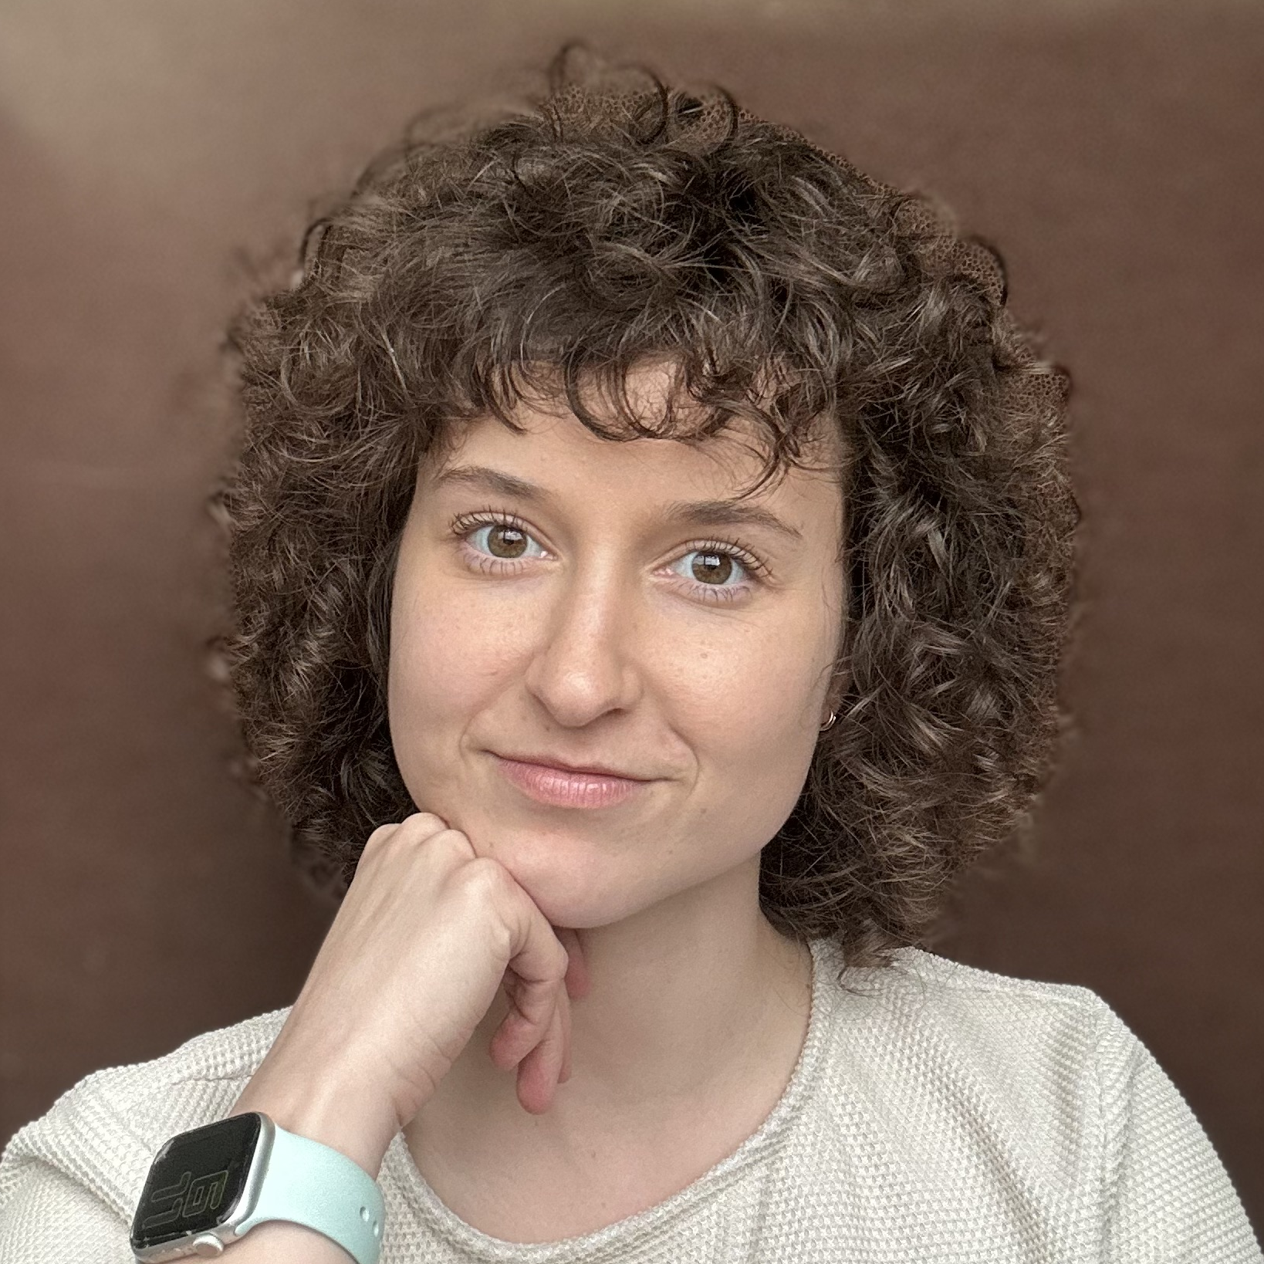
Abby Gottlich Manager Experiences
Email
abby.gottlich@thebridge.com
Location
Dallas, Texas
Mobile
(972) 948-0392
Abby has worked in technology and design for 8+ years. She’s done everything from visual design to web development to experience design. She currently focuses on User Experience Design and loves using data to drive her decisions.
The foundation of her strategy is figuring out the root of the problem. She’s not about putting lipstick on a pig and prides herself on finding valuable, long term solutions for complex problems. She also has 3+ years of front-end development experience, allowing her to understand technical feasibility and create scalable, component-based designs.
EXPERIENCE
Industry Experience
Healthcare, QSR, Technology, eCommerce, Education
Baylor Scott and White
Led the research, strategy, and design in examining high abandonment rates within the appointment scheduling flow. Strategized a simplified solution for guiding patients to the right type of care.
OOBE
Led strategy and design in building Chick-fil-A’s apparel ordering experience. Streamlined the Chick-fil-A Team Member hiring process eliminating the need for manual data entry. Moderated guerrilla usability testing and used learnings to inform design decisions.
Outback Steakhouse
Led the error handling strategy for out-of-stock and 86’d menu items. Designed appropriate messaging around errors to inform users and provide alternative exit flows.
SKILLS
Kudelski Security
Led research, strategy, and design to reimagine the report escalation process. Organized and facilitated multiple workshops to highlight friction points for analysts and their clients. Created a solution that enhances the report writing process and report quality.
Experience Design Strategy, User Research and Testing, Workshop Strategy and Facilitation, Front-End Development, UI Design

